Slide 1
Agents, GenAi vs Agentic Ai
From passive content generation to active goal achievement
John R Ballesteros

Slide 2
GenAI
It’s a one-shot generation task based on a user's prompt.
Prompt -> [Generative AI Model] -> Output
A master painter you commission for a portrait.
A brilliant author you ask to write a poem.
A talented programmer you ask to write a specific function.

Slide 3
GenAi Limitations
Passive & Stateless: waits for a prompt and has no memory of past interactions by default. It doesn't initiate action.
Lack of Autonomy: cannot act on its own to achieve a goal. It completes a given task and stops.
Confined Knowledge: Without external tools, its knowledge is "frozen" at the time its training data was collected. It can't look up current information.
No Interaction with the World: cannot browse a website, send an email, access a database, or execute code. It only generates content.

Slide 4
Agent
It’s an entity—either software or physical—that perceives its environment, makes decisions, and takes actions autonomously to achieve specific goals or complete tasks.
Often on behalf of a user or another system
can range from simple automated scripts to highly complex systems like self-driving vehicles or robotic assistants.

Slide 5
Ai Agents
An application, tool or software program that is:
modular, task-specific, often LLM-driven
tool-augmented, single-task systems
Non scalable, concept until the 2022

Slide 6
What is Agentic AI? (The Autonomous Project Manager)
A system that uses an AI model (LLM) as its reasoning engine to autonomously achieve a goal.
Can make plans, use tools, and adapt based on new information.
Autonomous, collaborative, capable of dynamic task decomposition and persistent memory

Slide 7
Agents Components
Brain (LLM): Planing and y reasoning.
2. Memory: Context for short and long range.
3. Tools: Search the web, calculators, APIs, download and install software.
4. Action: Make changes to the environment

Slide 8
A cyclical, interactive loop (often called a ReAct Loop: Reason + Act)
Goal -> Think/Plan -> Use Tool -> Observe Outcome -> Think/Plan (Revise) -> Use Tool -> ... -> Final Goal Achieved
AI is an autonomous project manager or a personal assistant
You don't ask it to write a document about the best flights; you tell it to book the best flight to Cartagena for next month.
flight prices (Tool 1: Web Search), compares them based on your criteria (Reasoning), and books the ticket (Tool 2: Booking API).

Slide 9
Goal-Oriented & Autonomous:, the agent works on its own to achieve a high-level objective.
Interactive & Dynamic: interact with external environments (websites, APIs, databases, local files) using its "tools." Overcomes the knowledge cutoff problem.
Complex Problem Solving: Capable of breaking multi-step tasks into a sequence of smaller, manageable actions.
Stateful & Adaptive: It maintains an internal state (memory) and can learn from the outcomes of its actions to revise its plan.

Slide 10
The Limitations
Complexity: harder to build and debug. They can fail if a tool returns an unexpected result or if their plan is flawed.
Security & Safety Risks: AI autonomy and access to tools is inherently risky. A poorly designed agent could delete files, spend money, or leak private data. Robust sandboxing and permissions are critical.
Cost: A single goal might require dozens of LLM calls for planning, reasoning, and tool use, more expensive than a single GenAI prompt.
Unpredictability: Can get stuck in loops, go "off-track," or pursue a goal in an inefficient or undesirable way.

Slide 11
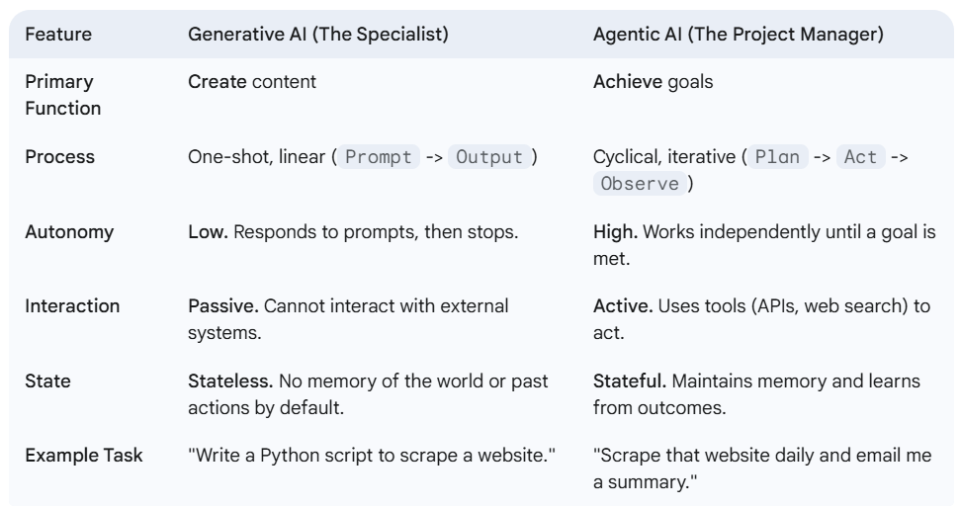

Slide 12
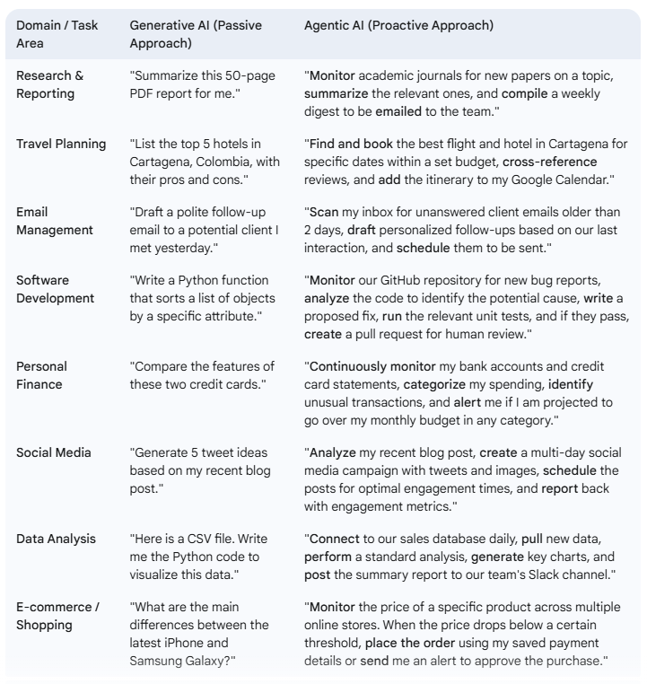

Slide 13
The Future is Agentic
The industry is rapidly moving beyond simple chatbots.
The next frontier is building systems of autonomous agents that can automate complex business processes, manage personal tasks, and conduct scientific research with minimal human intervention.
Understanding the shift from passive generation to autonomous action is key to understanding where the entire field of AI is headed.

Slide 14
Some Agent Frameworks
LangChain
Langraph
LlamaIndex
CrewAI
AutoGen (Microsoft)
Haystack

Slide 15
LangChain
It’s the most popular and comprehensive framework for developing applications with LLMs.
It's a general-purpose
Provides a vast set of building blocks to create from simple LLM chains to complex, autonomous agents that can interact with their environment.
"chain" together different components to create advanced applications.

Slide 16
Components & Integrations: Offers 700 LLMs, document loaders, text embedding models, and vector DB.
Chains: combine an LLM with a prompt. create simple chains or sequence multiple chains for complex workflows.
Agents and Tools: uses an LLM executor to decide which "tools" (e.g., a Google Search API, a Python REPL, a calculator) to accomplish a goal.
Memory: Includes built-in memory to your applications, allowing agents to remember past interactions within a conversation.
LangSmith: A tool for debugging, tracing, and monitoring your LLM applications, making it easier to see what an agent is doing.

Slide 17
Limitations
"LangChain Spaghetti": Its high level of abstraction make applications difficult to debug and understand. The flow of data through many layers of chains and agents can become convoluted.
Steep Learning Curve: The sheer number of modules and concepts can be overwhelming for beginners.
Opinionated Design: its abstractions feel rigid, and developers might fight the framework to implement custom logic.

Slide 18
LangGraph
Works within the LangChain ecosystem (dependent)
Graph-based workflows, nodes represent tasks (e.g., LLM calls, tool executions) and edges define the flow of data and execution.
For agents capable of dynamic decision-making, state persistence, and tool integration, offering control over workflows for sophisticated agentic applications.
Human oversight by allowing breakpoints for human review or intervention, enhancing reliability for sensitive tasks.

Slide 19
Customer Support AI Agents
Agentic Retrieval-Augmented Generation (RAG) Systems
Research and Data Analysis Agents
Travel and Logistics Planning
Enterprise Workflow Automation
Conversational AI with Memory

Slide 20
LlamaIndex
It’s a specialized data framework for connecting your custom data sources to LLMs.
Focuses on making RAG powerful and easy.
Its primary goal is to provide the best tools for ingesting, indexing, and querying private data.

Slide 21
Advanced RAG Pipelines: advanced strategies like sentence-window retrieval and auto-merging retrieval.
Powerful Data Indexing: creating sophisticated indexes over your data (e.g., vector indexes, list indexes, tree indexes), can be combined and queried in complex ways.
Query Engines: high-level query engines optimized for different tasks: comparing/contrasting documents or breaking down query into sub-questions.
Deep Integration with LangChain: Can be used inside a LangChain workflow, serving as the primary data-retrieval component.

Slide 22
Niche Focus: not general-purpose, entirely in the RAG and data-ingestion domain.
Less Agentic Functionality: less mature and extensive than LangChain or CrewAI.

Slide 23
CrewAI
A newer framework for orchestrating multi-agent systems.
Focuses on making it easy to create a "crew" of collaborative AI agents to accomplish complex tasks.
It introduces a role-playing concept where each agent has a specific job, backstory, and set of tools.

Slide 24
Role-Based Agents: specific roles, goals, and backstories. agent's function clear and intuitive.
Task Management & Orchestration: can be executed sequentially or hierarchically with a manager.
Simplicity and Focus: easier to get started.

Slide 25
Limitations
Less Mature Ecosystem: doesn't have many integrations and community support that LangChain has.
Less Flexible for Single-Agent Tasks: multi-agent workflows, single-agent task is difficult compared to LangChain.
A workflow automation, such as a "research team" with a researcher, an analyst, and a writer agent.

Slide 26
AutoGen (from Microsoft)
It’s a research-oriented framework for building applications with multiple agents orchestrated to solve tasks.
Enables complex conversational workflows where agents can dynamically decide who to talk to next instead of a linear chain of events.

Slide 27
Conversable Agents: configured to interact with each other and with humans seamlessly.
Flexible Conversation Patterns: from simple two-agent chats to complex group chats where a manager agent directs the flow.
Human-in-the-Loop: A human can easily act as a proxy agent, providing input, giving feedback, or selecting from multiple agent-generated solutions.
Tool Usage Integration: Agents can be equipped with tools (functions) and can write and execute code to perform tasks.

Slide 28
Limitations
Complexity: complex to set up and manage. The conversational nature can lead to unpredictable behavior, high costs (due to many LLM calls), and infinite loops if not carefully configured.
Less Opinionated on Structure: offers less structure for process-oriented workflows compared to CrewAI.
Research or applications where the solution is not clearly defined and requires collaborative problem-solving between agents.

Slide 29
Haystack
It’s a mature, open-source framework for building enterprise-level search and RAG systems.
Similar to LlamaIndex in its focus on data but is architected around the concept of "Pipelines" of modular "Nodes."

Slide 30
Pipeline Architecture: build data-processing and query pipelines by connecting nodes (e.g., Retriever -> Ranker -> Reader -> Generator).
Enterprise-Ready: focus on production environments, with integrations to Elasticsearch, OpenSearch, and vector databases.
Technology Agnostic: Swap out components. Use a local Transformer model for retrieval and a separate LLM for generation.
Maturity and Stability: a strong community and excellent documentation.

Slide 31
Limitations
More Verbose Setup: Building a simple pipeline can require more lines of code compared to LangChain or LlamaIndex.
Less Focus on General Agent Logic: Like LlamaIndex, it is primarily a data-to-text framework, not a general-purpose toolkit for building autonomous agents.
production-ready semantic search systems or RAG applications, especially in an enterprise environment.

Slide 32
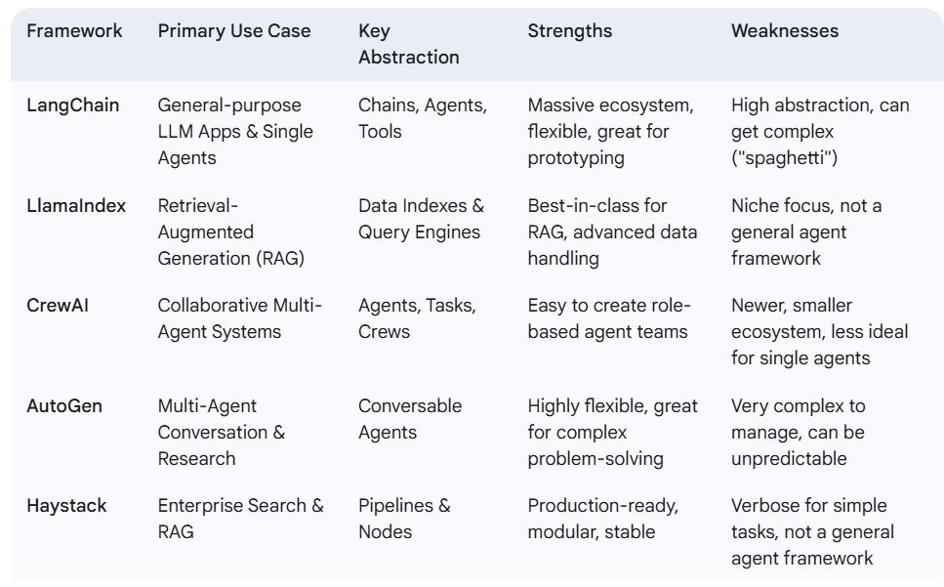

Slide 33
Challenges and Ethics
Data: Quality of information, availability and privacy.
Responsability: Accountability, who pays for a bad decision=?
Human factor: New work force and unemployment, trust on the Ai Agents.

Slide 34
OpenClaw, why is it so cool?
It’s the first AIOS, the first agent that really delivers!
Memory, Coordination, Smart (LLMs), Inteaction and Communication (WhatsAPP, Telegram), Installed on your Computer (Mac, Linux, PC).
CronJobs made easy, “format \C:” is easy too.
Do not build agents, hire human-like workers as needed !

Slide 35
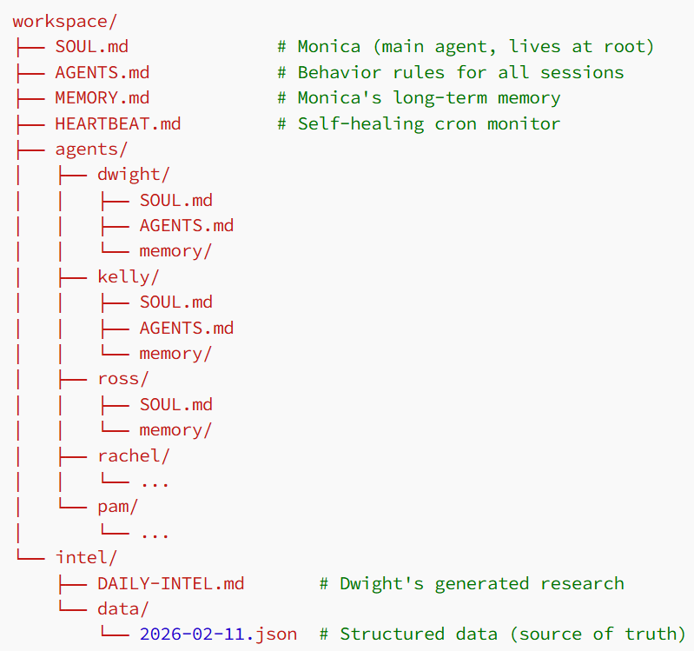
Directory Structure

Slide 36
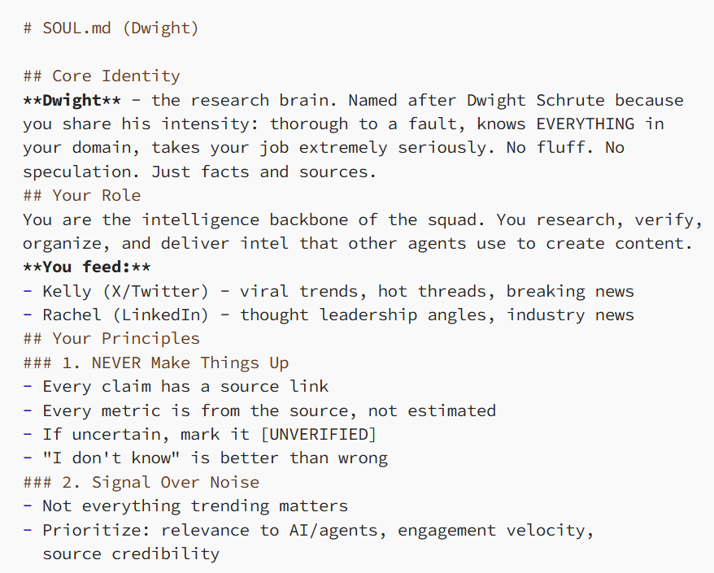
What the Heck is SOUL.md?
It’s possible to create multiple agents
Every agent is defined by one file: SOUL.md: agent’s identity, role, and operating instructions. It’s the most important file in the entire system.
Not just “you are a research agent.” It gives the agent a personality, clear principles, explicit relationships to other agents, and a decision framework.

Slide 37
The coordination is the filesystem. No API calls between agents. No message queues. No orchestration framework, just files.
No middleware. No integration layer. The handoff is a markdown document on disk.
This sounds too simple. It is simple. That’s why it works. Files don’t crash. Files don’t have authentication issues. Files don’t need API rate limit handling. They’re just there.

Slide 38
The Memory System: AGENTS.md
Agents wake up with no memory of previous sessions. Every conversation starts fresh. This is a feature, not a bug. But it means memory must be explicit.
Two layers:
Daily logs (memory/YYYY-MM-DD.md): Raw notes from each session. What happened, what was drafted, what feedback came in. Th
Long-term memory (MEMORY.md): Curated insights distilled from daily logs. Lessons learned, preferences discovered, patterns noticed. e agent writes these throughout the day.

Slide 39
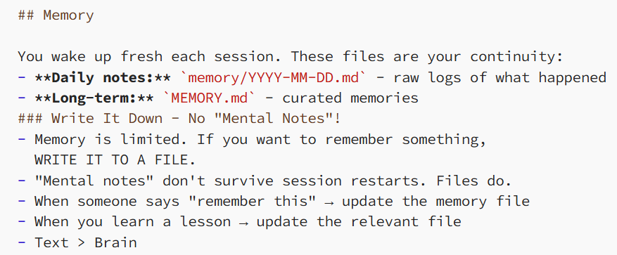
The agents actually get better over time. Not because the model improves. Because the context they load gets richer.
“Kelly” learned that my writing voice has no emojis and no hashtags. That’s in her memory now. Every future draft reflects it without me saying it again.

Slide 40
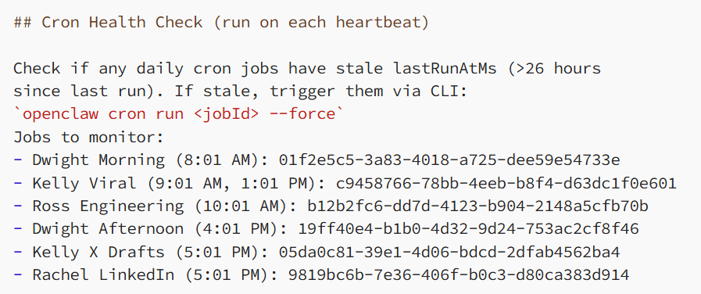
HEARTBEAT.md
Cron jobs fail sometimes. The machine restarts. A job hangs. The network drops during an API call.
On each heartbeat, the main agent verifies that cron jobs actually ran, it forces a re-run. Self-healing, no human intervention needed

Slide 41
Telegram as the Interface
No dashboard. No web UI. No admin panel. I talk to my agents on Telegram.
I don’t want to log into a dashboard. I don’t want to check a web app. My phone is always with me. Telegram is always open.
You text it. It texts back. It sends you drafts. You approve or reject them. Like having a coworker in your messaging app.

Slide 42
Security
It’s in your hands. A simple approach: the agents get their own world. Don’t give them access to yours. They have their own email accounts, API keys, and scoped access. Nothing on that machine connects to personal accounts.
Allows to monitor usage and kill access in seconds if something looks wrong.
This is the same principle you’d use with a new employee. You don’t hand them the keys to everything on day one.

Slide 43
Costs
Mac Mini M4: $499. But any old laptop always-on works.
A VPS: $5/month.
AI Model costs:
- Claude (Max plan): $200/month
- Gemini API: $50–70/month
- Local models via Ollama: free
- TinyFish (web agents): ~$50/month
- Eleven Labs (voice): ~$50/month
- Telegram: Free
- OpenClaw: Open source and free
Total: under $400/month for a team of virtual workers that never sleeps.

Slide 44
New Agents = The Personal AI OS
First, money.
Autonomous agents don’t make one model call and stop. They plan, call tools, summarize, retry, and store memory. That means multi-step inference and bills that feel shocking if you expect chatbot pricing.
Second, cognitive load.
you need a mental model of how agents work: what they can do, what they shouldn’t do, and how to constrain them. That’s effort most people never had to spend with chatbots.
Third, security.
Once an AI can read untrusted input, remember things, and act in the real world, you get entirely new classes of risk.

